Slide 1
Hospital Resource Prediction --------------------------------------------------------------------------------------------------------------- Predicting hospital bed usage and its effect on COVID-19 fatality rates.
Mahsa Aghaeeaval

Slide 2

Problem Definiton and Our Goal
Implementing various algorithms to create a prediction model that will predict when each country will run out of hospital beds.
Having such information can guide healthcare professionals with managing and allocation of their resources.
We then want to evaluate the effect of low hospital bed availability on fatality rate.

Slide 3

EDA Summary- Variables from raw data
What useful variables can we use from our raw data?
Number of new cases per day
Number of deaths per day
Number of recoveries per day
Number of tests done per day
Mask / Stay at home / school closure / travel restriction mandates
Date
Hospital capacity
Beds used by non-COVID cases
Beds used by COVID cases

Slide 4
EDA Summary- Variables created from raw data
Independent Attributes
Number of new cases per day
Number of deaths per day
Number of recoveries per day
Active cases per day
Per population
normalized
Number of tests done per day
Date
Number of new cases per day
Tests per day
Per population
normalized
Days since first case [1,365]
Mask / Stay at home / school closure / travel restriction mandates
Mandate or no mandate [0,1]
Target Attribute
Hospital capacity
Beds used by non-COVID cases
Beds used by COVID cases
Available beds per day
Per population
normalized

Slide 5
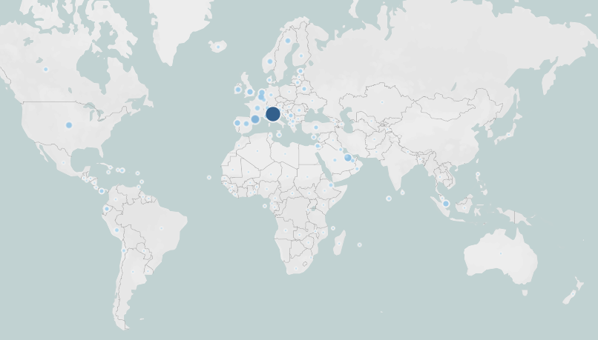
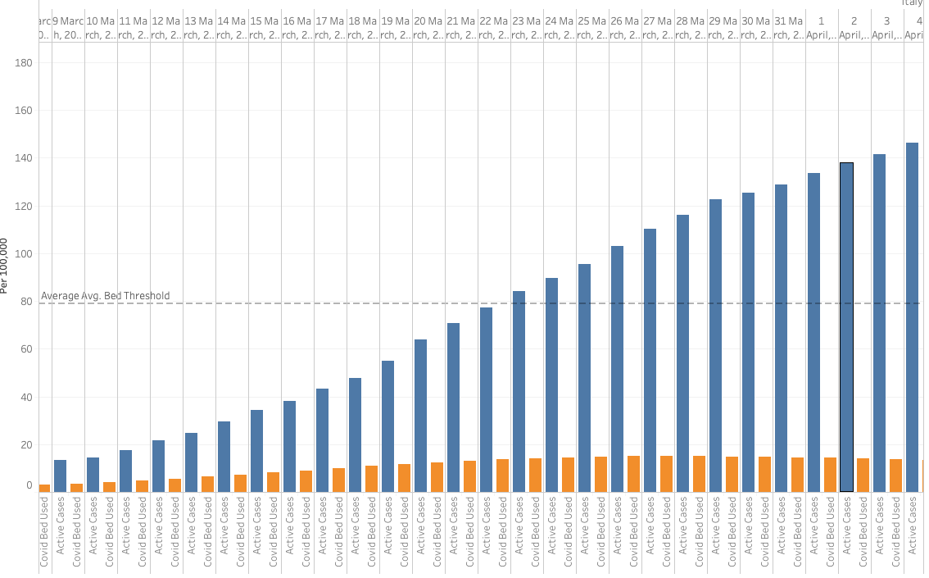
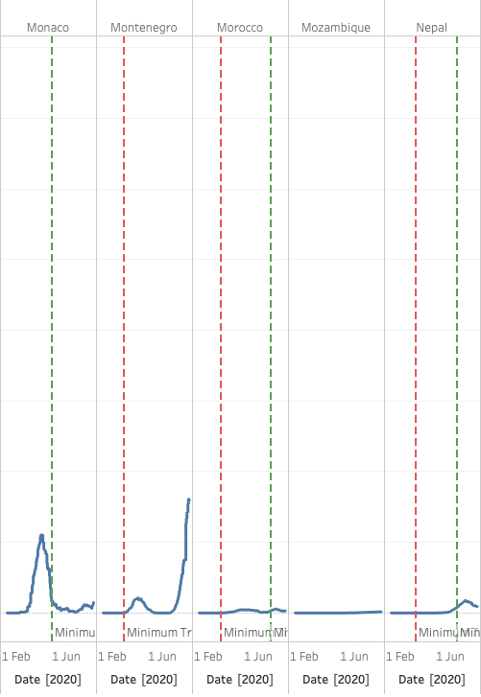
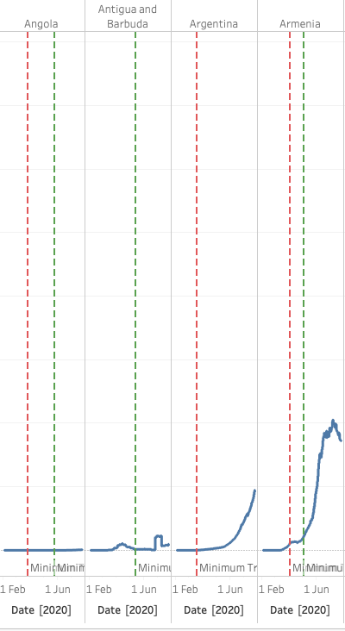
EDA Summary- Challenges
Checked for general trends in number of active cases
Cases go up starting mid-May, and for most countries decreases after the end of July
Italy seems to be an epicenter in Europe
United states continues to grow while most countries drop
Missing countries
Checking the severity of COVID hospitalization numbers
General trend as expected : as CVOID cases increase so does the rate of hospitalization.
Hospital capacity reference line: Why does it show that most countries are below their hospital capacity in terms of beds.
Checking the significance of mandates
increase in COVID trends AFTER travel restrictions are put in place
decrease in COVID cases after travel restriction were lifted
Various trends

Slide 6
EDA Summary- Solutions
Missing countries
Unique categorical column
Removed
Not enough examples of countries hitting 0 hospital bed capacity
Check model with regression scores first
If regression models do not perform well, Could be a classification problem.
Low/med/high
Clarifying Trends
Binary to multinomial
[0,1] → [0,1,2]

Slide 7
Overview
Introducing four Models
Evaluate model performance for predicting number of available beds
Target attribute = number of available beds
Evaluate model performance for predicting fatality rate
Target attribute = rate of fatality
Pick the best model (1 out of 4)
Generate future data
Pass future data into our chosen model to predict future number of available beds per country for future dates.
Target attribute = number of available beds
Uses future data and future number of available beds (obtained in previous step) to predict future fatality rates.
Target attribute = fatality rate
Compare how the number of available beds (capacity) affects the rate of fatality.

Slide 8
What models are we trying?
Linear Regression (base-line)
Random Forest
Neural Net – MLP
Neural Net - LSTM

Slide 9
Why did we choose these models?
Linear Regression
Simplicity
Baseline model
Random Forest
Less influenced by outliers
Can handle collinearity
Neural Net – MLP
Can learn from faults
Used for complex problem solving
Neural Net – LSTM
More complex than MLP
Better for time series data
Deals with vanishing gradient problem

Slide 10
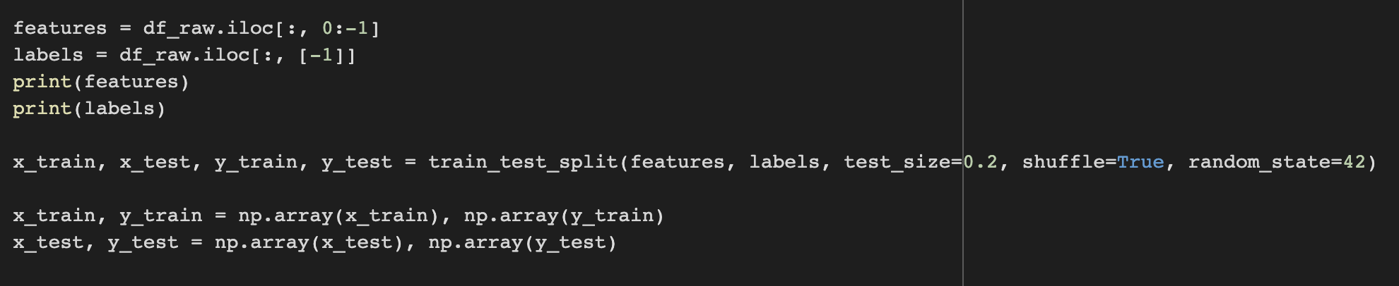
Data Preparation – Part 1
Splitting Data
Attributes used
Independent Attributes
Target Attribute
Available beds
Day since first case
Total test
Active cases
Travel mandate [0,1]
Stay home mandate [0,1]
Education mandate [0,1]
Business closure mandate [0,1]
Strict gathering mandate [0,1]

Slide 11
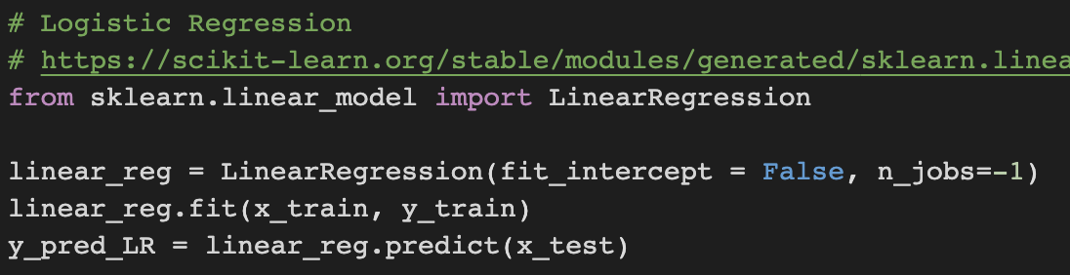
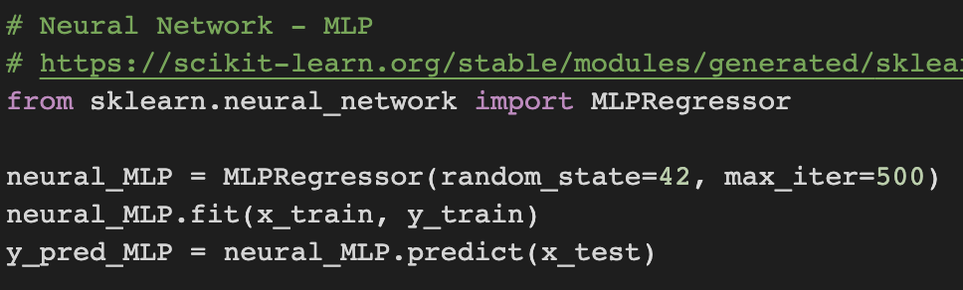
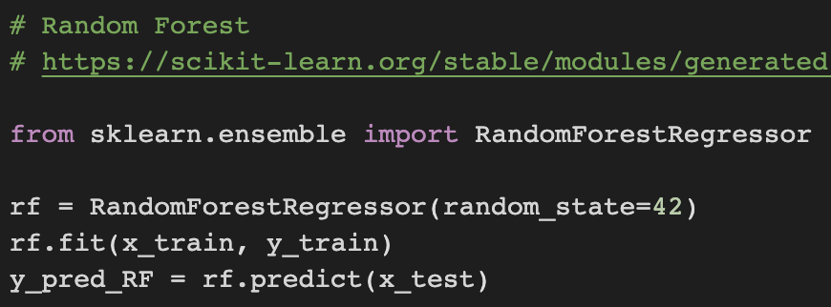
Training Models
Linear Regression
Neural Net - MLP
Random Forest

Slide 12
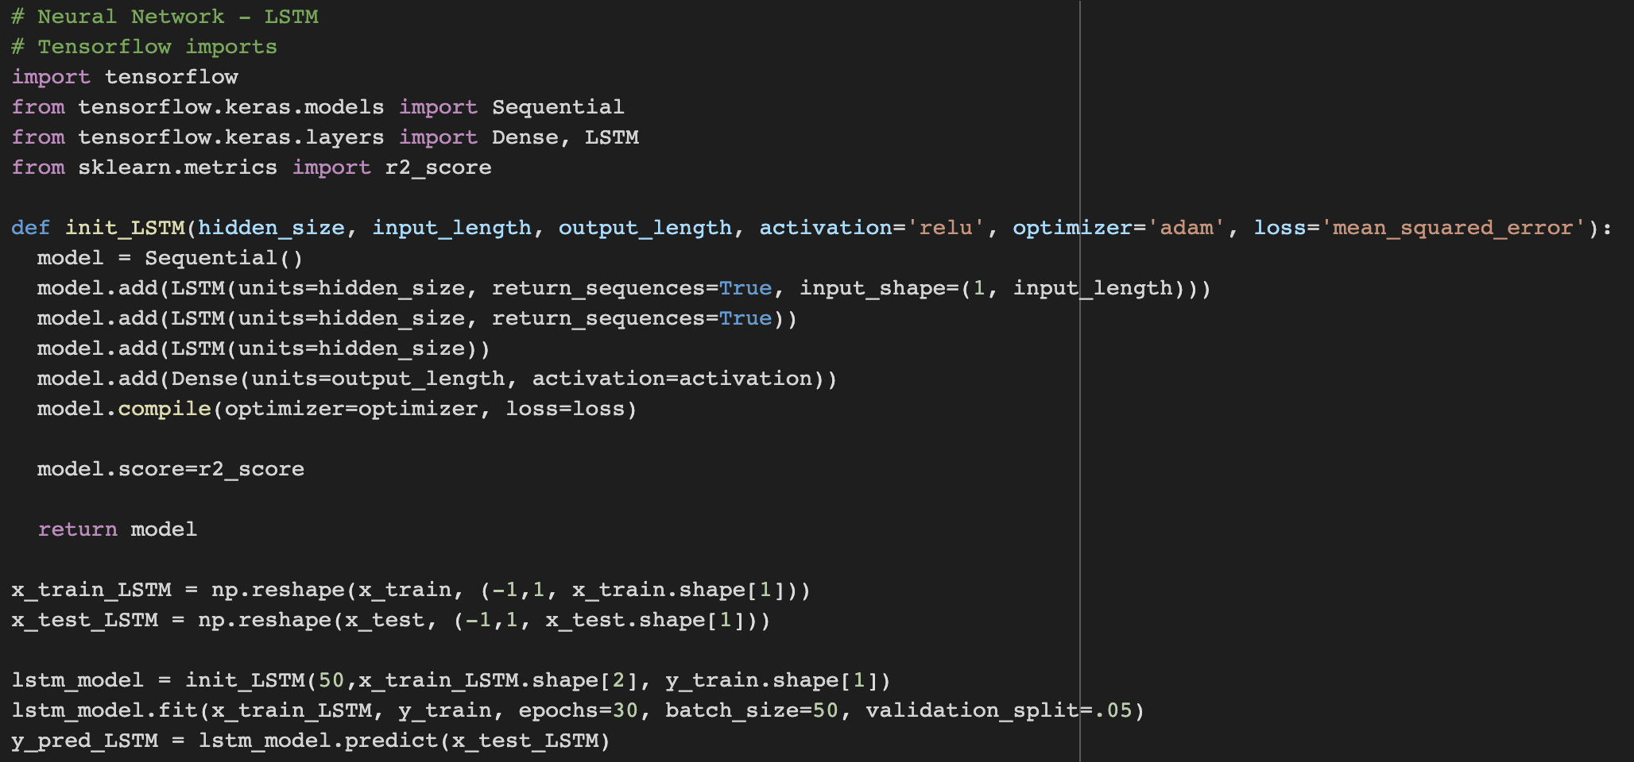
Training models continued
Neural Net - LSTM

Slide 13
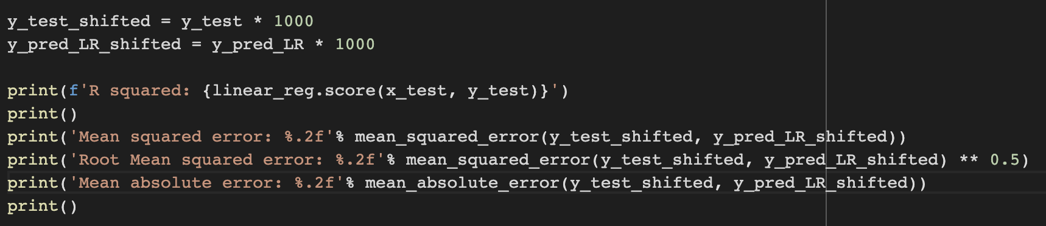
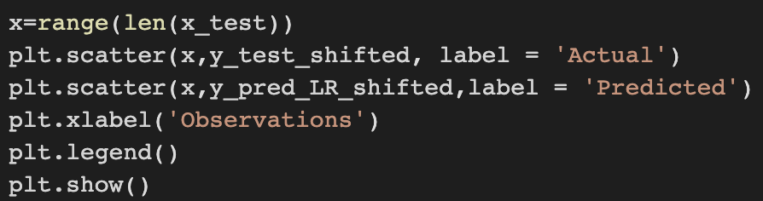
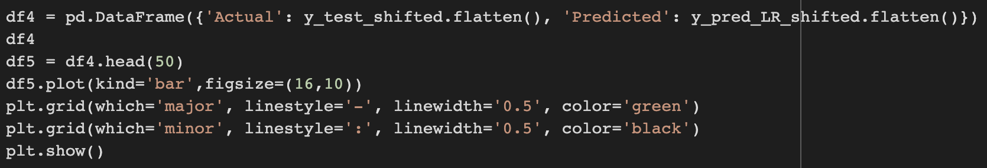
Evaluations - Code
Statistical scores
1. R squared
2. Mean squared error
3. Root mean squared error
4. mean absolute error
Actual vs predicted graph
Residual error graph
Actual vs predicted graph bar graph

Slide 14
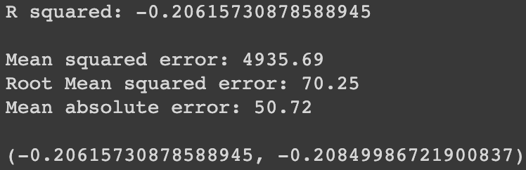

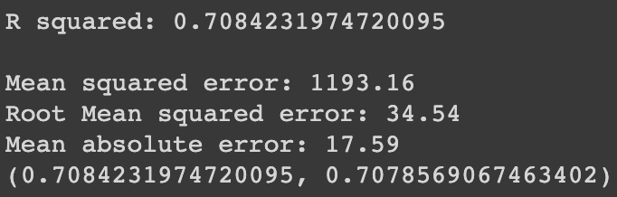
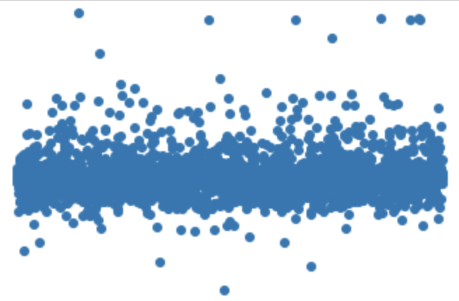
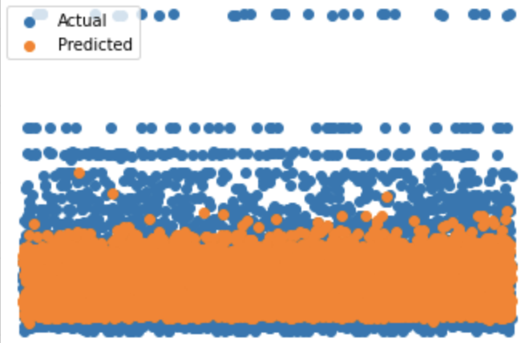
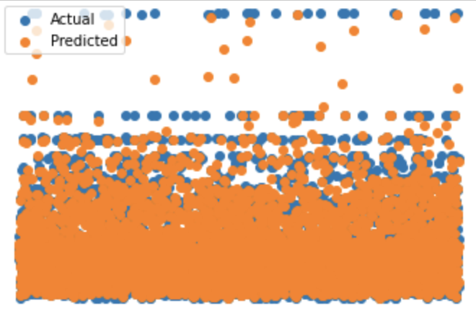
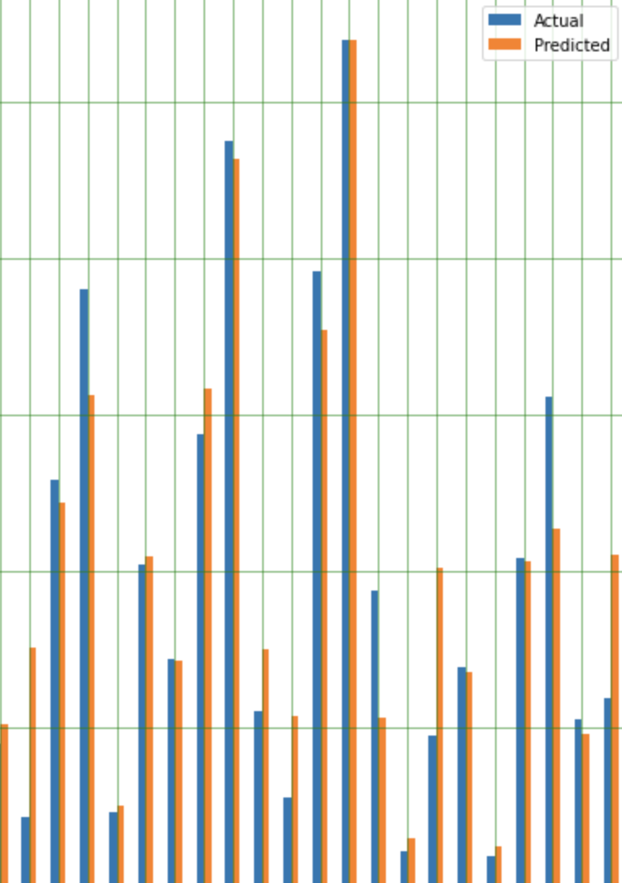
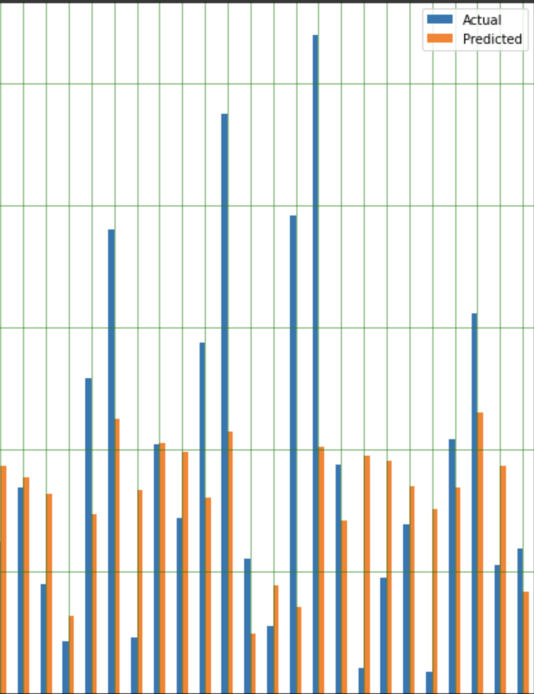
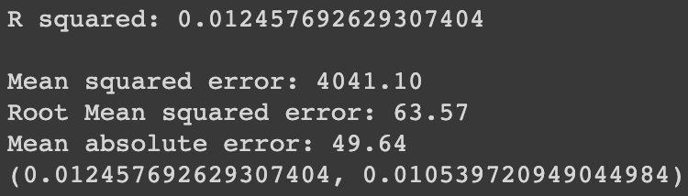

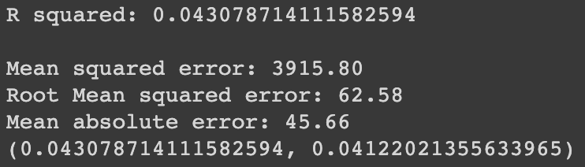
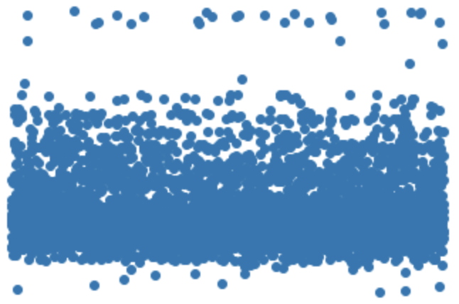
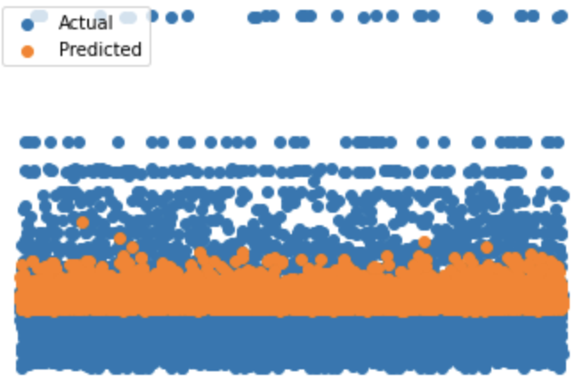
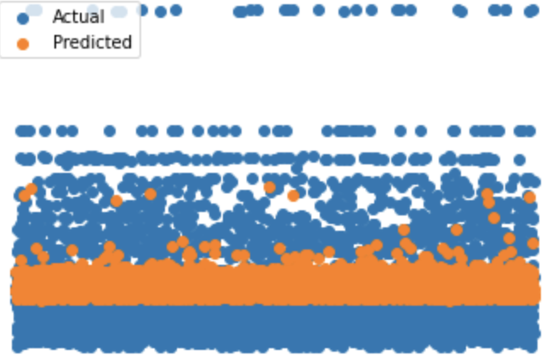
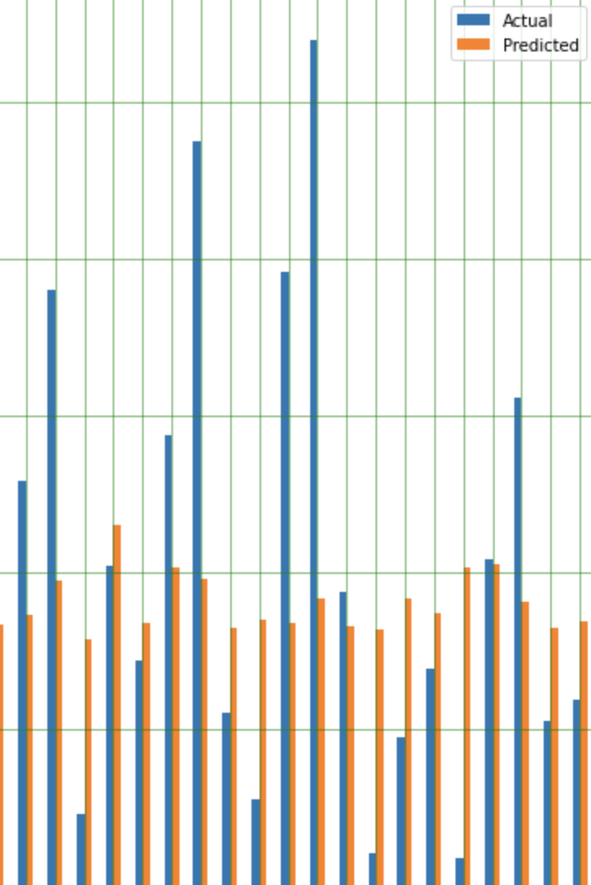
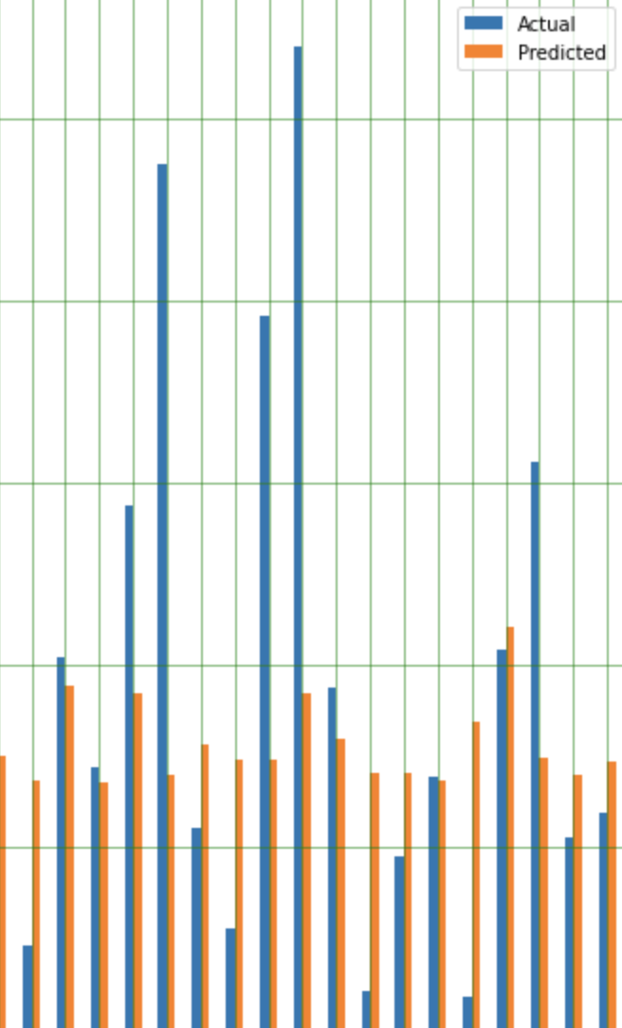
Linear Regression
Random Forest
Neural Net - MLP
Neural Net - LSTM

Slide 15
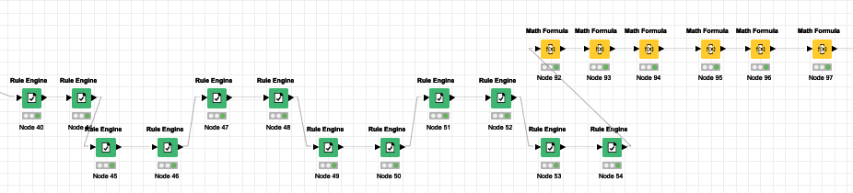
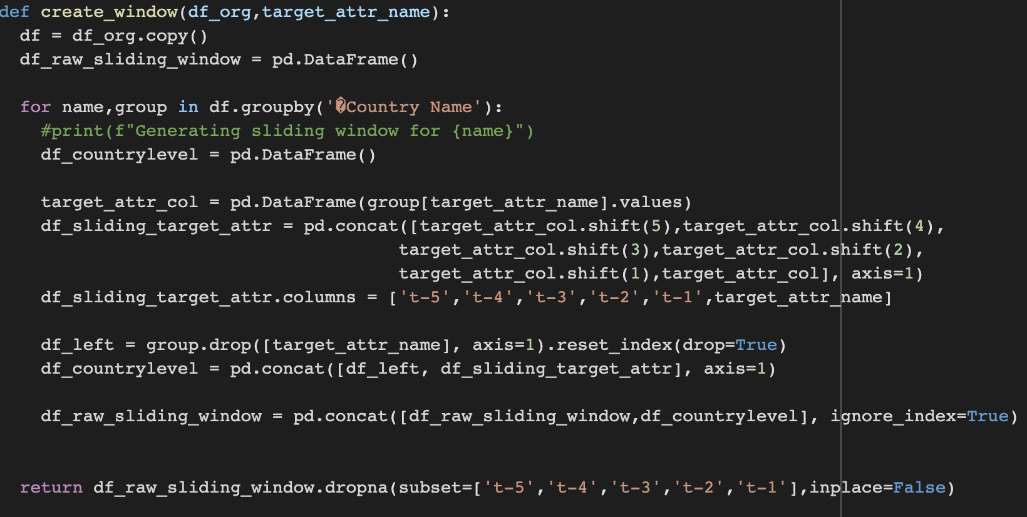
Data Preparation – Part 2
Multinomial from Binary
Sliding Window

Slide 16

Data Preparation – Part 2
Splitting Data
Attributes used
Independent Attributes
Target Attribute
Available beds
Day since first case
Total test
Active cases
Travel mandate [0,1,2]
Stay home mandate [0,1,2]
Education mandate [0,1,2]
Business closure mandate [0,1,2]
Strict gathering mandate [0,1,2]
Sliding window (adds five columns)
Based on available beds

Slide 17
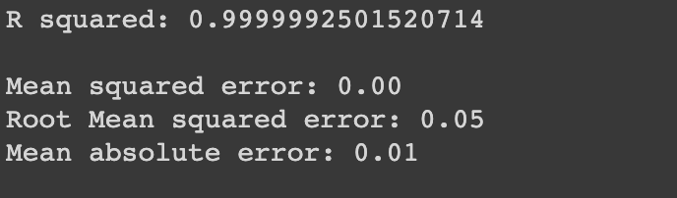
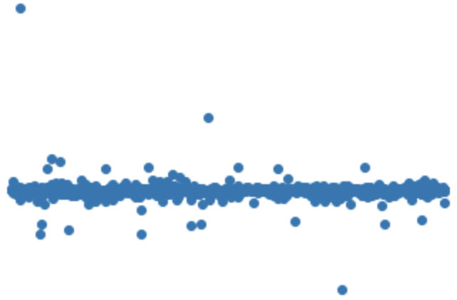
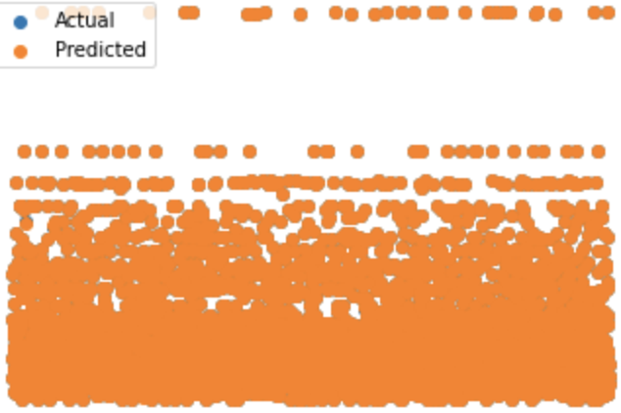
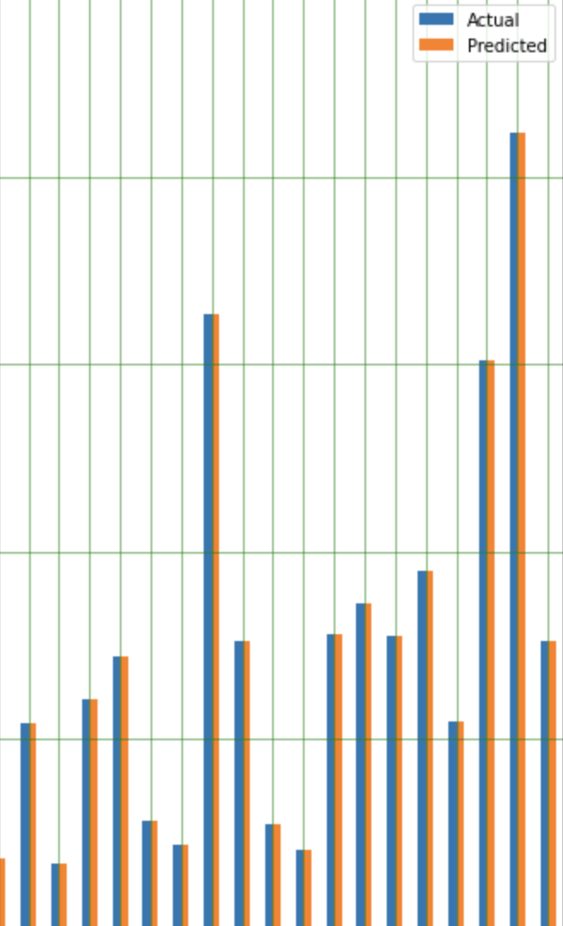
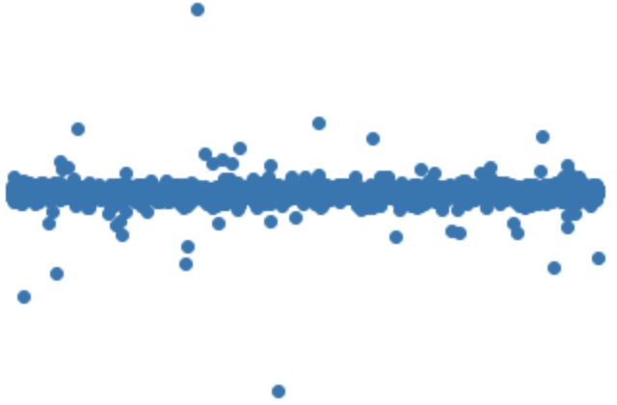
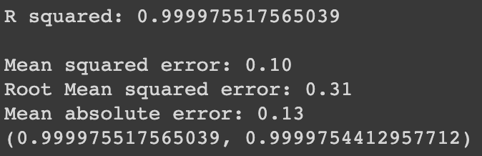
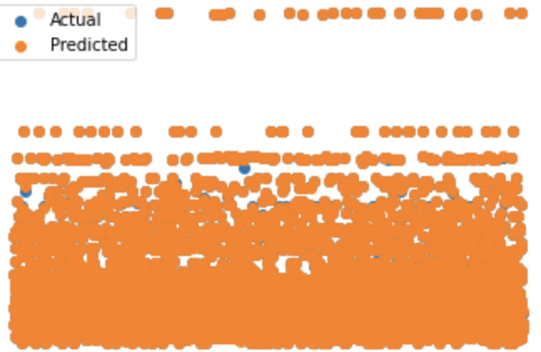
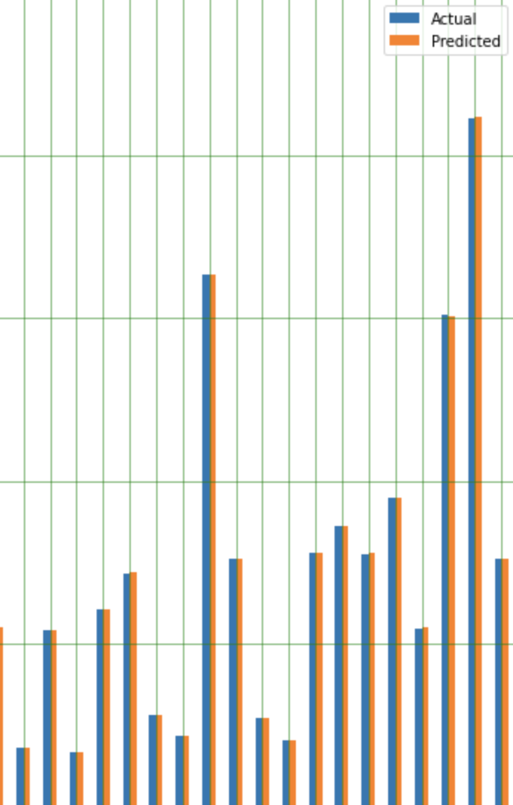
Linear Regression [old data]
Linear Regression [new data]
Random Forest [old data]
Random Forest [new data]

Slide 18
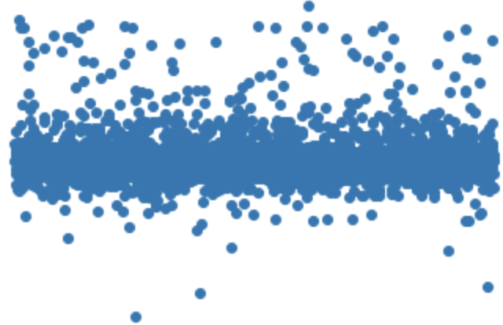
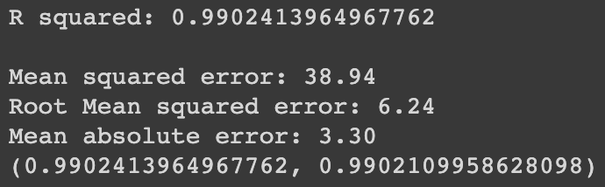
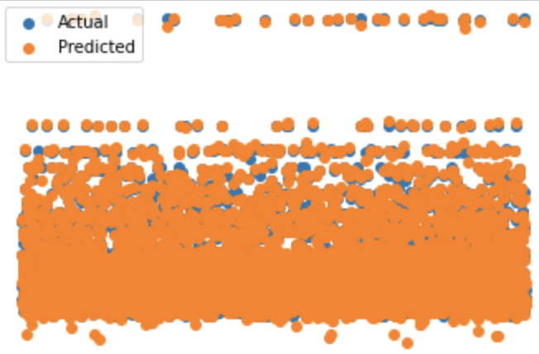
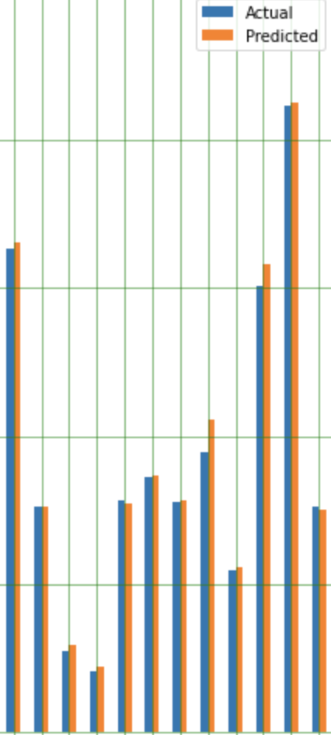
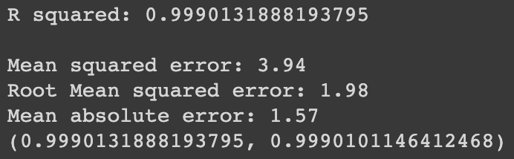
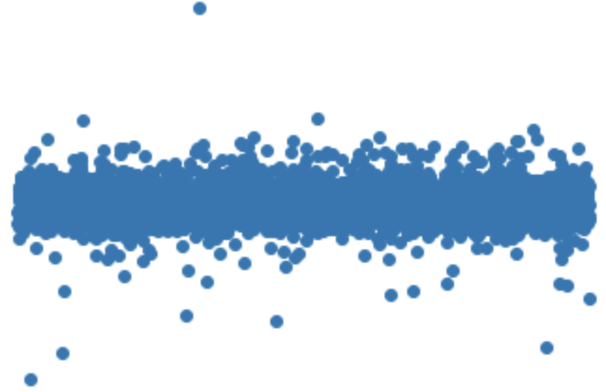
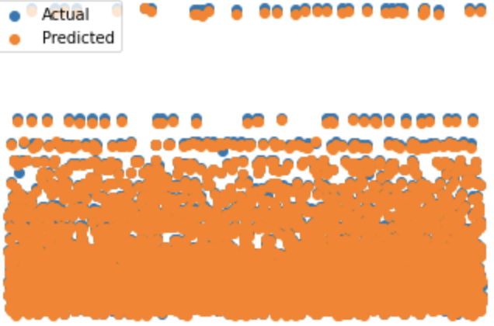
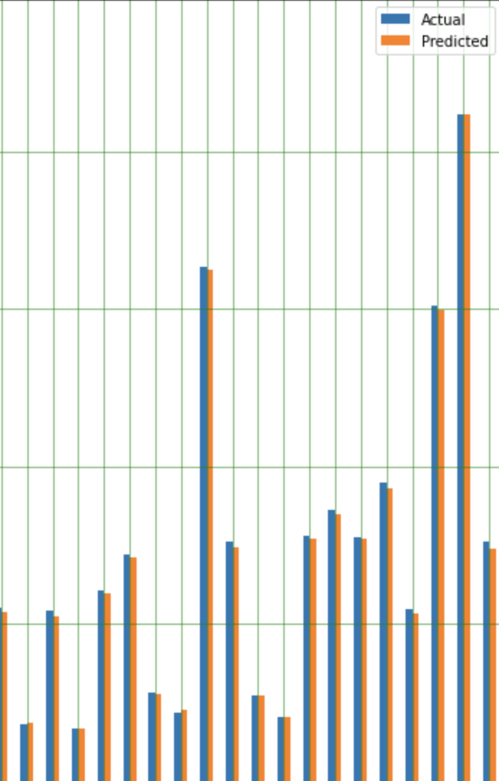
Neural Net – MLP [old data]
Neural Net – MLP[new data]
Neural Net – LSTM [old data]
Neural Net – LSTM [new data]

Slide 19
Data Preparation – Part 2
Attributes used
Independent Attributes
Target Attribute
Fatality rate
Day since first case
Total test
Active cases
Available beds
Travel mandate [0,1,2]
Stay home mandate [0,1,2]
Education mandate [0,1,2]
Business closure mandate [0,1,2]
Strict gathering mandate [0,1,2]
Sliding window (adds five columns)
Based on fatality rate

Slide 20
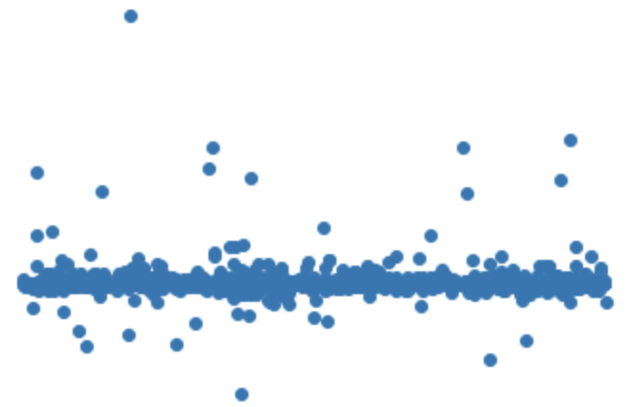
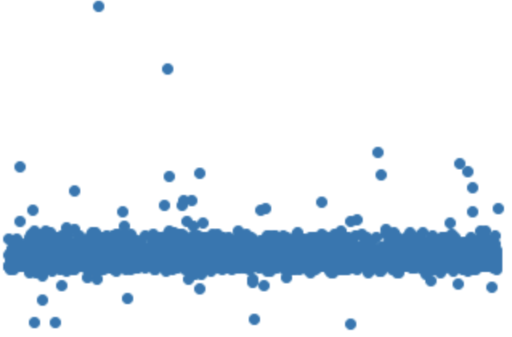
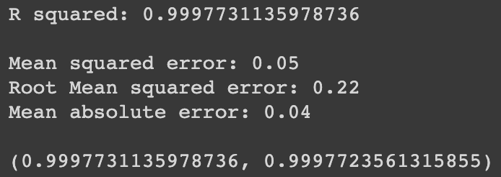
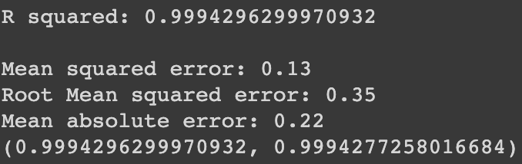
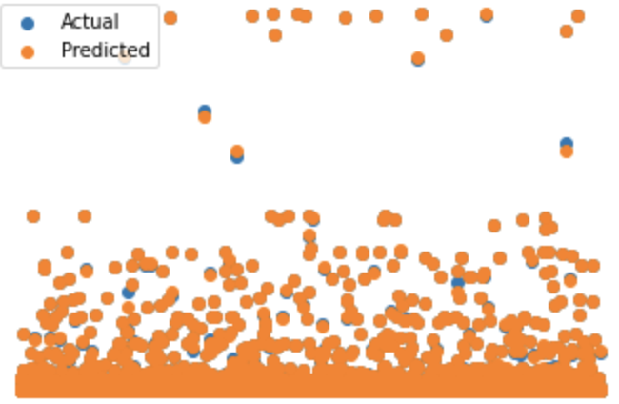
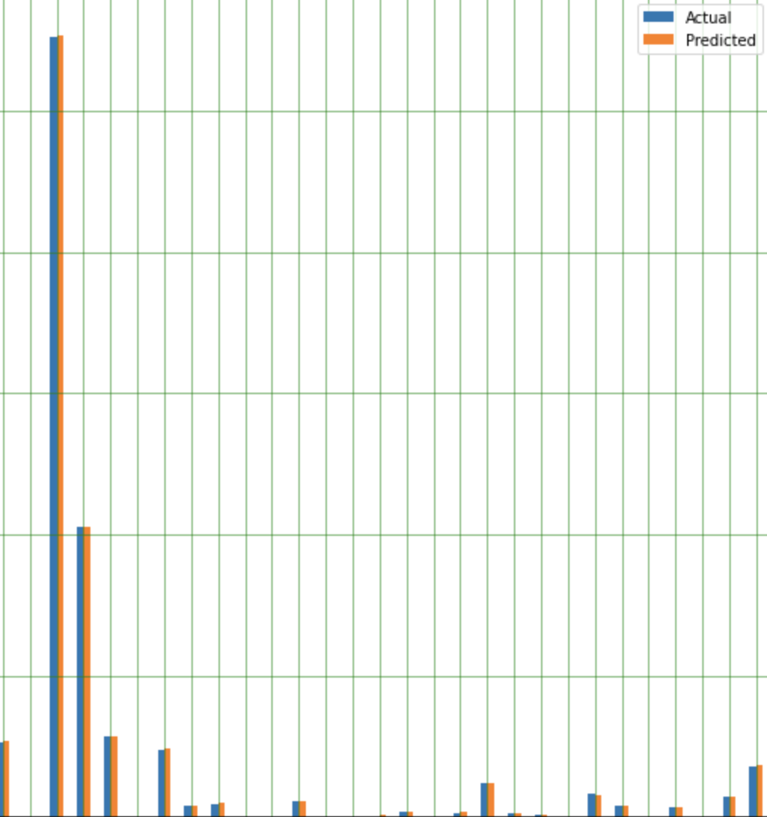










Linear Regression
Random Forest
Neural Net - MLP
Neural Net – LSTM

Slide 21


Best Model?
Linear Regression
Random Forest
Neural Net – MLP
Neural Net - LSTM

Slide 22

Generating future data
Why do we need to generate future data?
We can pass future attribute values into our best model and predict future numbers of our target attribute, which right now, is number of available beds .
Future data generated from past data
Future data generated till November 2020
Module used : fbprophet

Slide 23



When will each country run out of hospital beds?
Train model using past available beds data
Now instead of testing models using test data, we now test model using future data to obtain future number of available beds
Now we have future number of available hospital beds

Slide 24


When will low hospital bed capacity affect rate of fatality?
Now we want to predict future fatality numbers based on our new hospital bed numbers.
Train model using past fatality rate data
Append future available hospital beds to future data being its used as test data because now our target attribute is fatality rate and available beds becomes an independent attribute.
Now instead of testing models using test data, we now test model using future data to obtain future number of fatality rates
Now we have future number of fatality rates

Slide 25








Workflow clarified
Can predict available beds and fatality well
Best model
Dataset 1 (bad data)
good performance
Generate future data
Models
LR
RF
Models
LR
RF
Use future data to predict number of beds available in the future
Compare number of available beds with fatality rate
MLP
LSTM
MLP
LSTM
Bad performance
Dataset 2 (good data)
Predict future fatality using future number of available beds
Added new attributes
Append future values of available beds as an independent attribute
Cannot predict available beds and fatality well

Slide 26

What does our final data set look like ?
Since we took country out before training models, first we need to add it back in
Quick look into the file

Slide 27







How does hospital bed capacity affect rate of fatality ?

Slide 28


Why good models, but bad results ?
If our models gave us good performance scores, why can’t we see a relationship between rate of fatality and number of available beds?
Feature importance
Linear Regression
Random Forest
Available beds
Sliding window
Sliding window

Slide 29
Future Work
K- fold validation
Adding significant attributes
Longer time frame for future data
Try more regression models
Try switching to a classification problem
Try with province/state level data

Slide 30
Resources Used
Related articles used to evaluate our models / results
https://towardsdatascience.com/how-to-evaluate-your-machine-learning-models-with-python-code-5f8d2d8d945b
https://towardsdatascience.com/a-beginners-guide-to-linear-regression-in-python-with-scikit-learn-83a8f7ae2b4f
https://towardsdatascience.com/time-series-analysis-in-python-an-introduction-70d5a5b1d52a
https://statisticsbyjim.com/regression/overfitting-regression-models/
Data sources
http://www.healthdata.org/covid/data-downloads
https://data.humdata.org/dataset/novel-coronavirus-2019-ncov-cases
https://data.worldbank.org/indicator/SP.POP.TOTL
Data preparation and statistics
KNIME
Python (sliding window)
Data visualization
Tableau
Python
Modeling
Python (google Colab)

Slide 31

Thank you for listening

